Slide 1




Competences 4.0
New employers´ requirements for employees regarding Industry 4.0

Slide 2
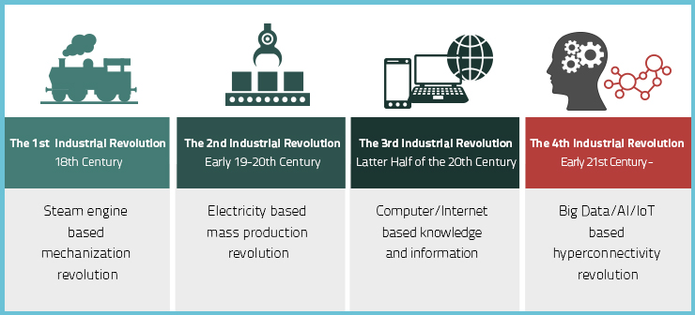
INDUSTRY 4.0

Slide 3
INDUSTRY 4.0
automation of traditional manufacturing and industrial practices,
modern smart technology,
M2M communication,
IoT,
self monitoring,
diagnose issues,
without human intervention
(source: Wikipedia)
Notes:
The Fourth Industrial Revolution (or Industry 4.0) is the ongoing automation of traditional manufacturing and industrial practices, using modern smart technology. Large-scale machine-to-machine communication (M2M) and the internet of things (IoT) are integrated for increased automation, improved communication and self-monitoring, and production of smart machines that can analyze and diagnose issues without the need for human intervention

Slide 4
I4.0 COMPONENTS
Mobile devices
Cloud computing
Internet of things (IoT) platforms
Location detection technologies (electronic identification) - Smart sensors
Advanced human-machine interfaces
Big analytics and advanced processes - Big Data
Multilevel customer interaction and customer profiling
Horizontal and Vertical System Integration
Augmented reality/virtual reality
On-demand availability of computer system resources
Simulation
Cyber Security

Slide 5
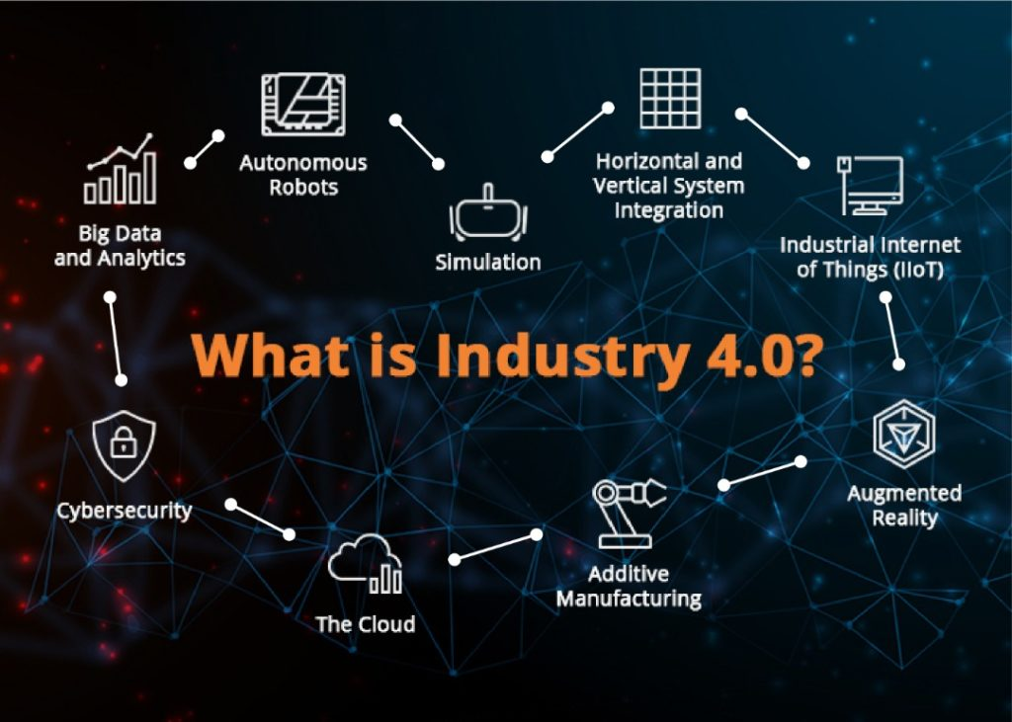

Slide 6
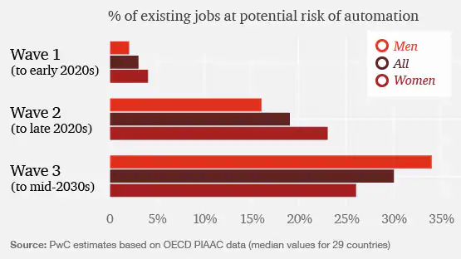
I 4.0 and Labor market
Notes:
PWC analysis estimates three evolution waves of Industry 4.0. (W1: algorithmic, W2: augmentation, W3: autonomy) In the first phase, a negative impact on women's employment is expected, and only in the third phase (2030 -) could there be a more massive replacement of human resources by robots, machines and augmented and virtual reality.:

Slide 7
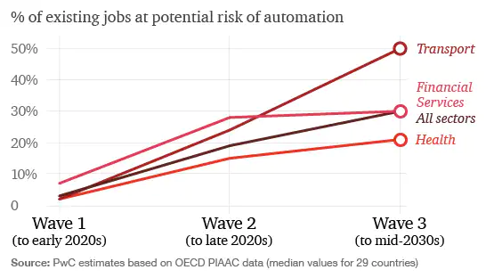
Potential job automation rates by industry across waves
Notes:
the financial and insurance sector has the highest share of existing jobs at potential high risk of automation in W1, the transport and storage and manufacturing sectors have lower potential automation rates in the Algorithm wave, but this picks up to higher levels by the time of the Autonomy wave (W3) in the 2030s (by which time use of driverless vehicles is likely to become more widespread across the economy)

Slide 8

New competences, new skills and new thinking
to avoid the risk of this replacement, it is necessary to change competencies, skills of employees, to change education at basic, high and vocational schools.

Slide 9

Three scenarios for development of qualification requirements
Growing Gap
General Upgrade
Central Link
Notes:
Growing Gap – scissors will be more and more opened between low and highly skilled employees. General Upgrade - growing demand for higher qualifications, the need for higher qualifications for all; Central Link
- higher qualifications for professionals and related specific professions.
-

Slide 10
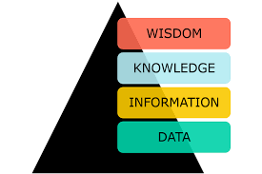
Prediction of labor market development in Industry 4.0
elimination of routine activities,
change of Job duties,
better knowledge of IT and company SW,
soft skills.
Notes:
Study of the Confederacion of Industry of the Czech Republic – companies estimate elimination of routine activities = extension of qualification and operation more machines at once. Digital technology will change job duties. Requirement for improving of IT knowledge and firm software. Soft skills – ability for team cooperation and interdisciplinary communication,

Slide 11
New competencies of new employees
Project orientation
Goal focus / not on the way
Teamwork + AR/VR
Value chain
IT systems
Data and project management
Soft skills and foreign languages
Notes:
The Focus on the goal not on the way how to do it – it means clearly defined goals or milestones, time and budget framework. Teamwork is interdisciplinary cooperation among workers with different skills and level of education. They will use IT media, virtual forms of collaboration and project management. Basic knowledge of the Value chain – it is interconnected processes – from supplier, production through marketing to sales. Skills related to the use of IT, company software, application programs and automated systems. Data and project management – ability to data evaluation.

Slide 12
Competence questionnaire
Sections:
Required competencies of students
Working with data
Corporate education
Communication, teamwork and productivity
Notes:
It will help to define the necessary knowledge of students (acquired during their studies) regarding the use of new technologies of digitization and robotics for future employment. Obtained information will be used for the preparation of digital educational modules for teachers and students. Respondents can answer four sections of questions. They select the appropriate answer (various digital tools that they use in their company and vocational school students should know).

Slide 13
Competence questionnaire
Link: https://forms.gle/YTebcuvLqzckCC2o7

Slide 14
Conclusion
To prepare children
For new world (for the future)
Technology skills
Practical use of IT and applications
Soft skills developing
Artificial intelligence = teacher
Teacher = a guide to learning and world, to encourage and help with problems
Notes:
Schools prepare children for a world that no longer exists. Instead of it they should focusing on technology skills, the basics of programming and working with data or developing soft skills including communication, the ability to learn, collaborate and solve problems independently.
Curricula should be based on studies and company experiences to prepare children for the professions of the future and to be able to adapt flexibly to the ever-changing technological environment.
At the same time, artificial intelligence itself has the potential to change education, take on a number of teaching tasks and adapt teaching to individual students. Among other things, he / she can evaluate how the student understands the curriculum, identifies mistakes or weaknesses and, based on this, can create a tailor-made task or exercise for everyone. The teacher thus returns to what is the purpose of his work: to be a guide to learning and the world, to educate, encourage and help with problems.

Slide 15
Digital literacy will be as important as reading, writing and counting.
Thank you.
Tomas Prchal
Chamber of Commerce and Industry Jihlava

